Slide 1

Chemical Espionage
A MODEL OF BUTTERFLY AND WASP INTERACTIONS USING DIFFERENTIAL EQUATIONS
ABIGAIL BALLARD, AUROD OUNSINEGAD, AND DASHON MITCHELL
COACHED BY DR. CHRISTOPHER MITCHELL
TARLETON STATE UNIVERSITY

Slide 2

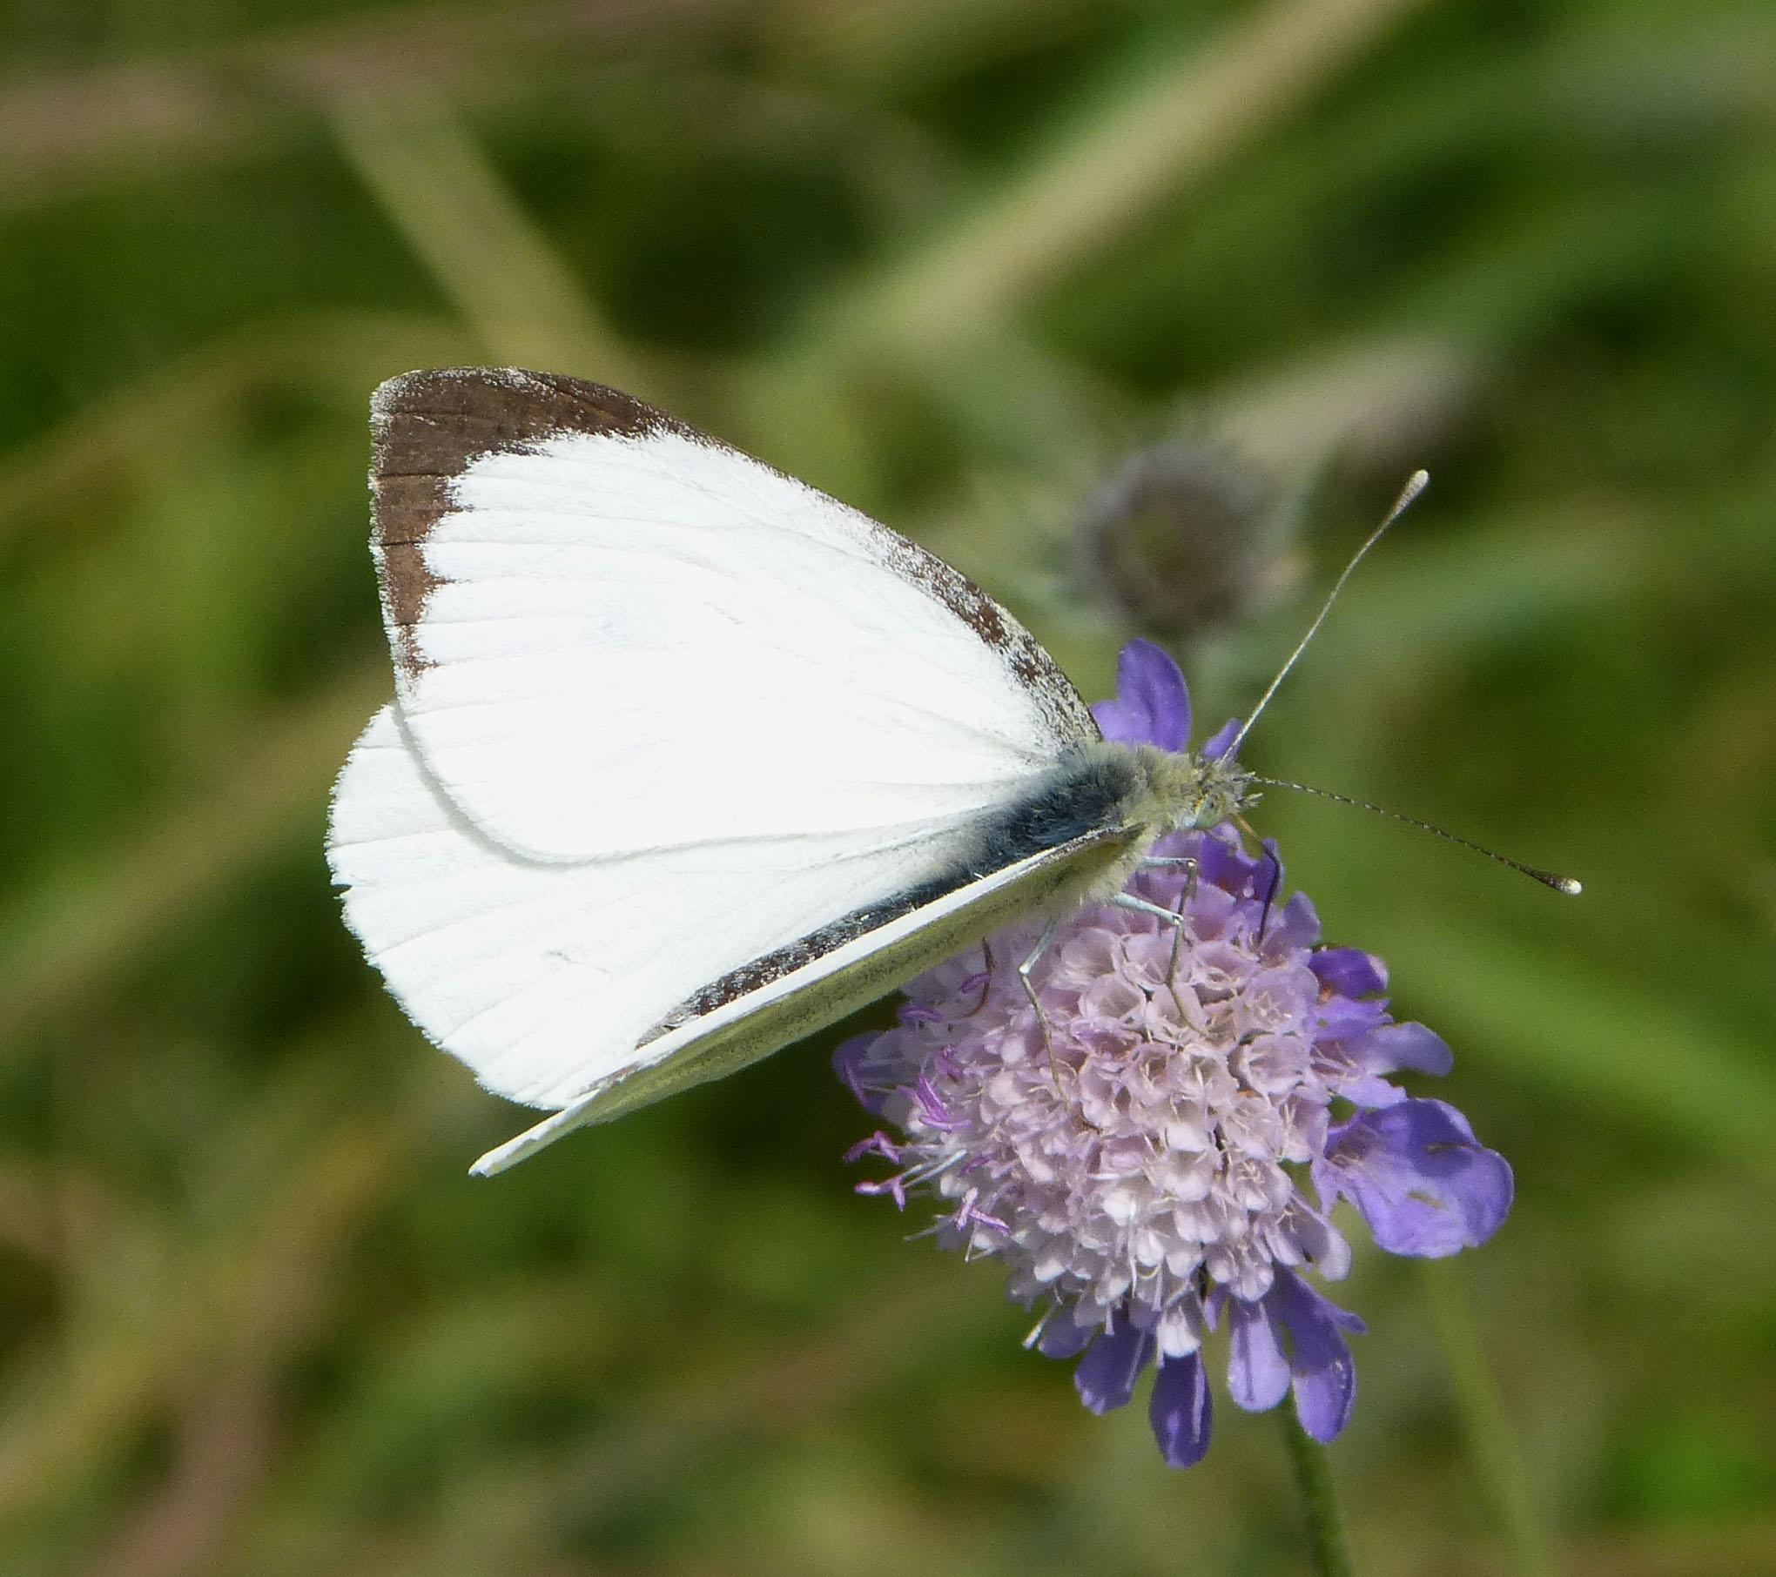
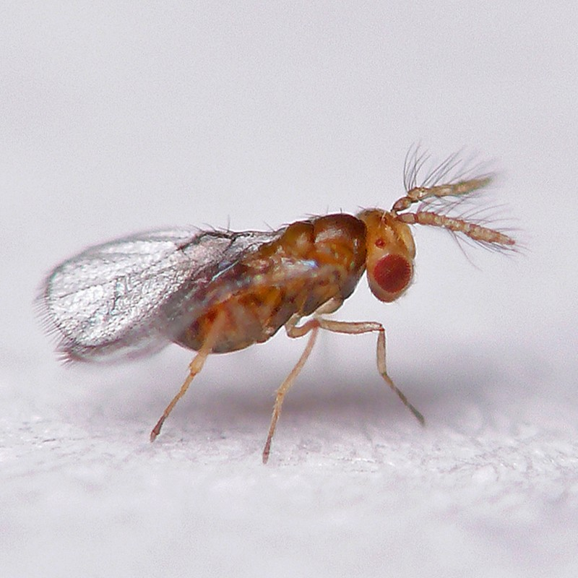
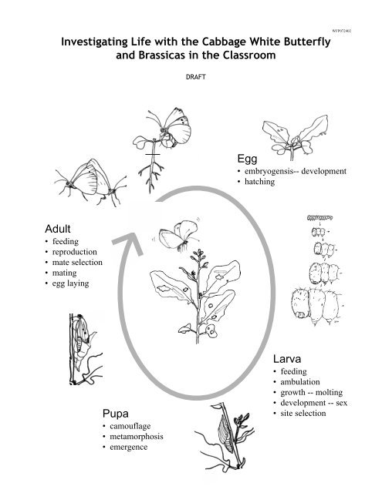
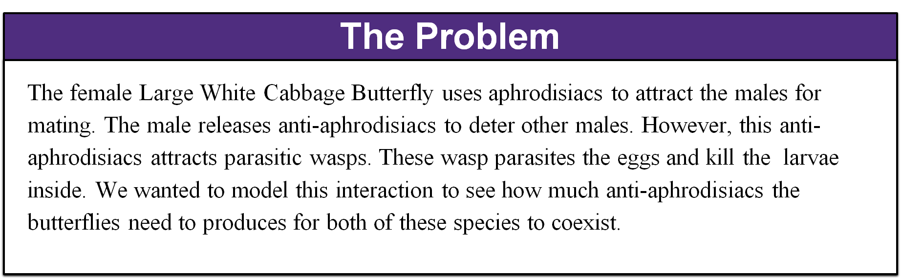

Slide 3
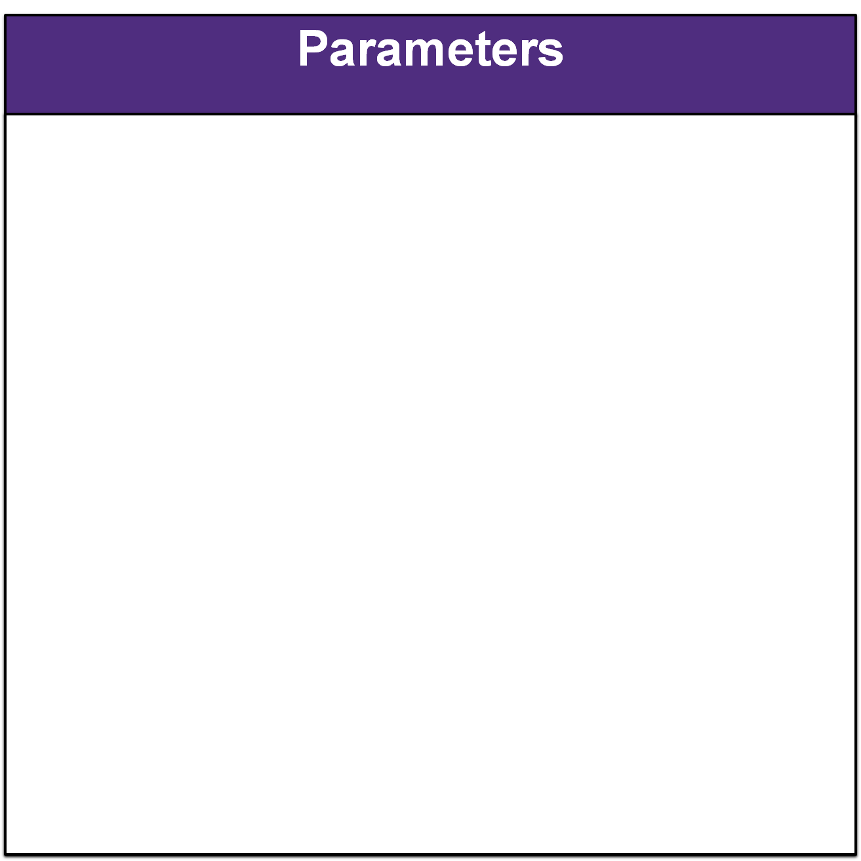

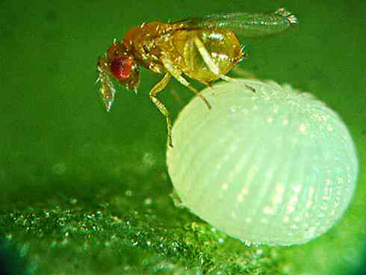



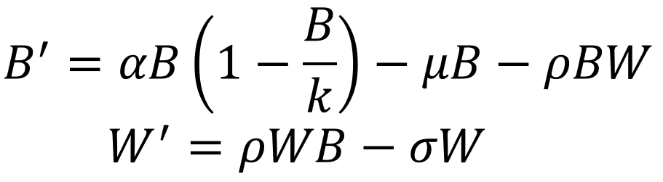


Parameter | Description | Value | Assumptions
k | Carrying capacity | Varies | Varies with equilibrium
α | Birth rate of butterflies | 25 | Each butterfly lays 20-50 eggs
µ | Death rate of butterflies | 20 | High death rate since they are preyed upon frequently
ρ | Amount of anti-aphrodisiac | Varies
σ | Death rate of wasps | 12 | Natural Death Rate
W | Wasp population |  | Measured in tens
B | Butterflies population |  | Measured on tens

Slide 4










Explanation of the Differential Equation Model
Yellow: Rate at which the butterfly population is increasing.
Green: Rate at which butterflies/wasps die within their population.
Pink: Interaction rate between the anti-aphrodisiacs, the butterfly population, and the wasp population.

Slide 5
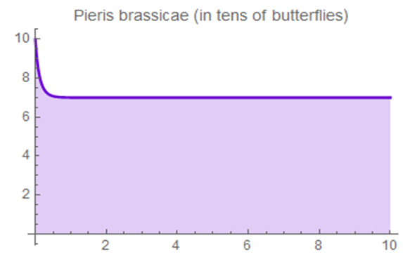

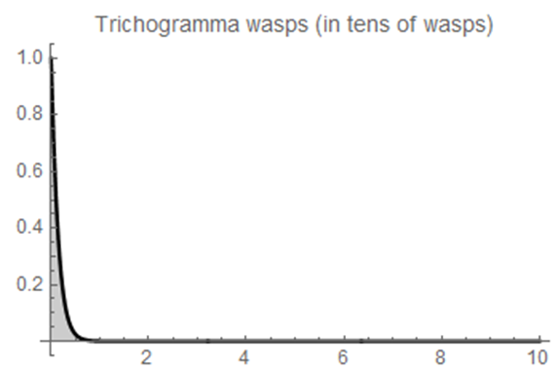
- Wasps aren’t able to find enough eggs to parasitize
- Butterfly populations grows to carrying capacity without any predators to hunt them.

Slide 6
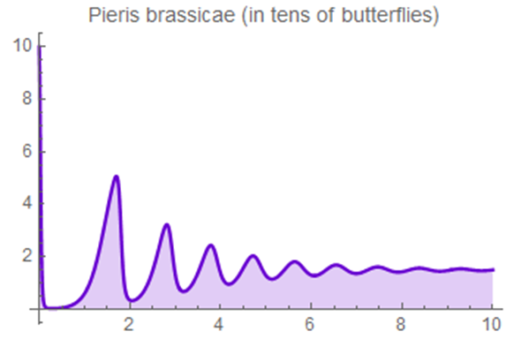

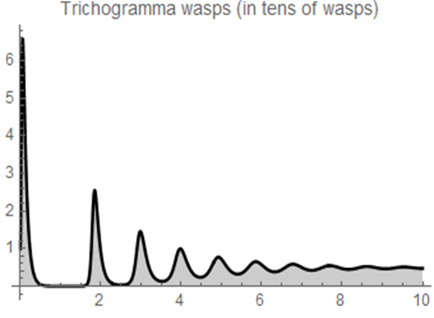
Coexistence present, but small variations could drive population extinct.

Slide 7
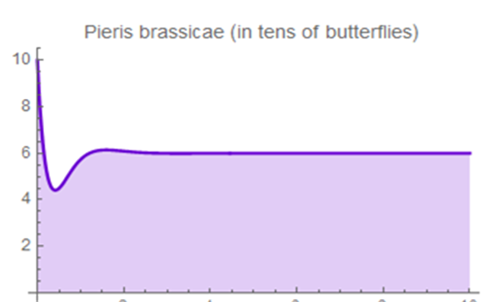

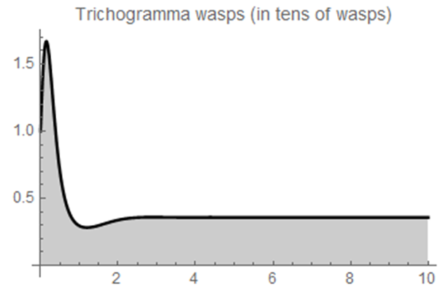
Coexistence present at stable amounts for both species

Slide 8
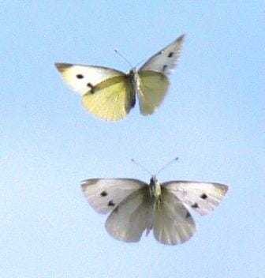
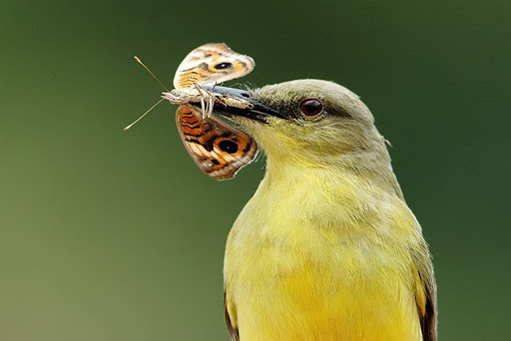
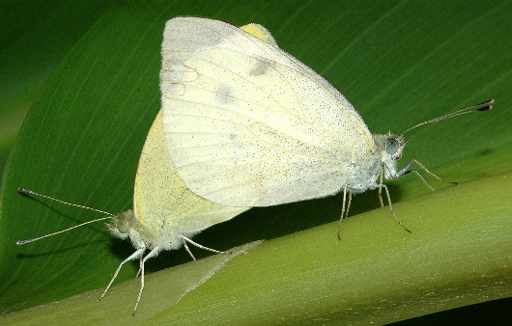

We found that the amount of anti-aphrodisiacs to achieve coexistence is 2 millimeters.
This result also agrees with the research we conducted for this project which also stated that males produces 2 millimeters on average.
My future work includes:
Including more predators in this model like birds.
Include equations on male butterflies and eggs.
Add in more variables to make the model more accurate such as temperature/climate.

